Slide 1
The User Experience and Accessibility of Gutenberg
Claire Brotherton, A Bright Clear Web
WordCamp Edinburgh, 17 November 2018

Slide 2
What’s Gutenberg?
New WordPress editor coming in WordPress 5.0
For WordPress.org, not WordPress.com (yet)
Block-based editor
First released as a plugin June 2017
Over 600k active installs
Gutenberg replaces the Classic Editor, which will be a plugin
Nov
19
Nov
27
Notes:
27 November is Giving Tuesday, just after Cyber Monday
“There’s no time in the holidays that’s a really good time for code deployment” – JJJ, WPWeekly Episode 338
Development via GitHub, not Trac
WordCamp US is 7-10 December

Slide 3
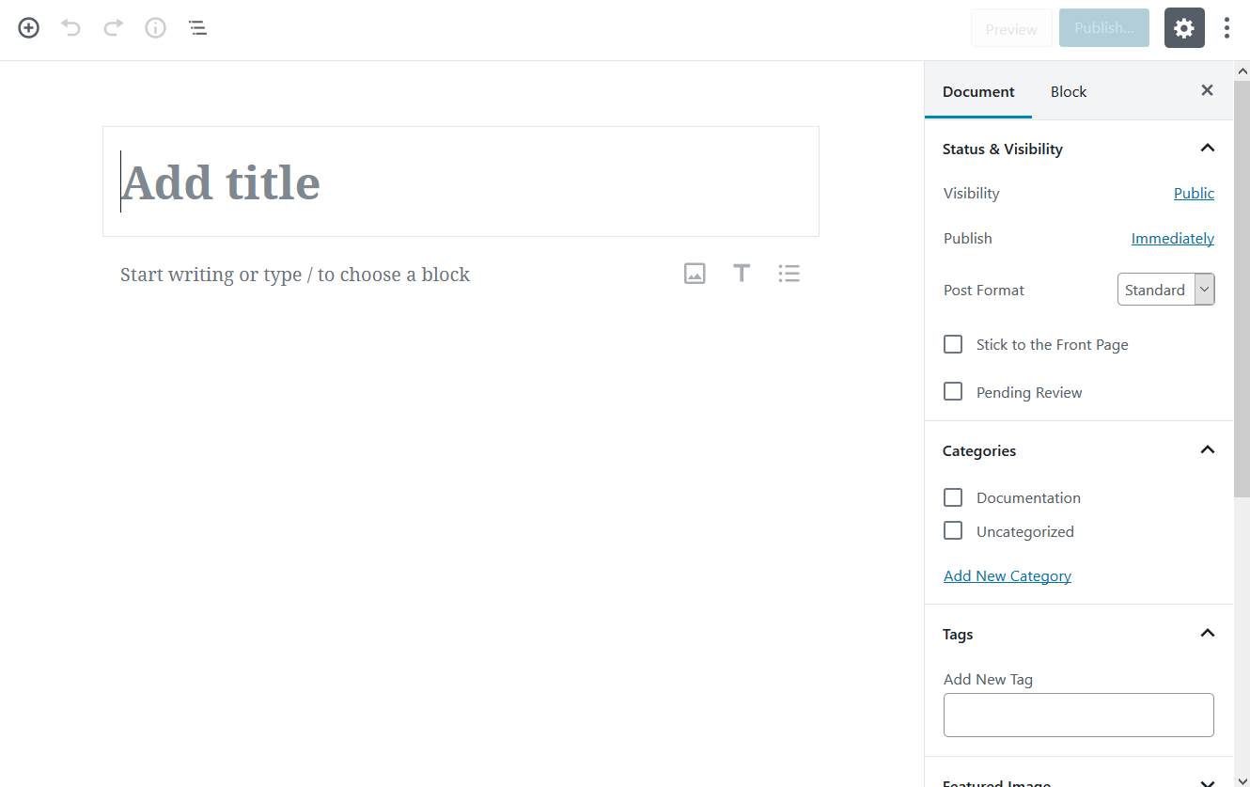
How did we get here?

Slide 4
What makes a great editor?
WordPress Design Team asked in January 2017

Slide 5
What do users want from a new editor? (1)
I always felt that the Editor is way too complex. The buttons, the hidden menus, the many fields, the help.
A lot can be done to improve upon current workflow of revisions. A lot of WP users are pretty much unaware of how it works.
The Editing experience needs to be akin to the many page builders that are currently out there. The ability to add rows and multiple columns is a must have!
…better visual representations of whatever you’re editing…
What if we took a mobile first approach for a new editor experience in core? Doing that would make pain points even more apparent…
…with blocks, your content would be more flexible. You can style blocks differently, sort blocks, create different UI’s for each block, etc.
Notes:
Simplification
Discoverability
Design/structure
Mobile first

Slide 6
What do users want from a new editor? (2)
#1: A good editor produces simple markup that’s accessible and portable from theme to theme.
#2: A good editor helps users focus on communicating, not designing.
This UI needs to be complex, because it is used for so many different types of input. Most people don’t use all of the possibilities within one post or page — that’s a good thing. But don’t make it difficult to get to any of them, because you don’t know what they might want (and it can change right in the middle of creating).
https://make.wordpress.org/design/2017/01/11/what-makes-a-great-editor/
Notes:
Accessible
Communication
Multi-use

Slide 7
How do users add content to WordPress?
https://twitter.com/abrightclearweb/status/895555456340344833
Notes:
Not everyone has the “write in WordPress, publish” workflow.
Other editors/tools mentioned: Google Docs, Word, Notepad, Grammarly, Vim, Evernote
Some people wanted to vote for both options
Assuming people may add content from other sources should be part of the workflow

Slide 8
Problems with the existing editor
Useful tools can be hidden away (Screen Options)
Shortcodes are ugly to use
Not obvious what content you can embed and how it works
Difficult to build complex layouts
Not a true WYSIWYG experience
Mobile experience is poor

Slide 9
Aims of Gutenberg
https://github.com/WordPress/gutenberg/blob/master/docs/reference/faq.md
“The editor will endeavour to create a new page and post building experience that makes writing rich posts effortless, and has “blocks” to make it easy what today might take shortcodes, custom HTML, or “mystery meat” embed discovery.”
Notes:
3 elements – a builder, ease of use, discoverability
Win users in other markets (Squarespace, Wix, Medium)

Slide 10
User Experience (UX) Principles
useful
usable
desirable
valuable
findable
credible
accessible
Notes:
By Peter Morville – via Accessibility Scotland
Useful. Not in question! Essential.
Usable. The editor should be able to be used as intended.
Desirable. The editor should be something people want to use.
Findable. Users should find what they need in the UI to complete their objectives.
Accessible. Gutenberg should be accessible to people with disabilities (~20% of the population).
Credible. Users should trust and believe in the editor.
Valuable. The editor should advance the WordPress project, opening up new possibilities.

Slide 11
What do users think of Gutenberg?
(so far)

Slide 12
User Testing of Gutenberg
David Bisset, high school students: http://davidbisset.com/gutenberg-and-youth-generation-x-and-generation-y/
10up, June 2018: https://10up.com/blog/2018/user-testing-gutenberg/
10up, November 2018: https://10up.com/blog/2018/testing-the-gutenberg-publishing-userflow/
All small scale studies
No major problems found

Slide 13
User Reactions to Gutenberg (WordPress.org)
> 1, 500 users
Nearly 57% 1 star reviews
But these are all-time reviews, not separated by version
Notes:
Data from 14.11.18 (Wednesday)
A lot will have sampled earlier versions of Gutenberg

Slide 14
But…
“I just calculated the average for the last 90 reviews and it is exactly 2.31 (including 47 one star reviews out of the most recent 90 total)…. it is clear the plugin is not ‘wowing’ potential users.”
Erick Danzer, Imagely
- Makers of the NextGEN Gallery plugin
https://www.imagely.com/defer-gutenberg/, published 14.11.18
Notes:
Article published 14.11.18 (Wednesday)
One of a number of voices calling for a delayed release – Yoast, Mark Root-Wiley, Morten

Slide 15
User Reactions to Gutenberg (WordPress.org)
I put off using Gutenberg until now as I wasn’t ready for the change. I finally installed it on one of my blog sites and I was pleasantly surprised.
I found it relatively easy to use and navigate the various options. I love the blocks system and creating attractive blog posts has never been easier.
https://wordpress.org/support/topic/gutenberg-is-great-and-easy-to-use/
Notes:
“It’s also so easy to edit with Gutenberg. I like how you can move the blocks up and down and change it to different formats.”
“It makes it easier for my older, less tech-savvy clients to manage their own content in a much cleaner manner (I’m no longer seeing them adding unnecessary spaces between paragraphs or stumbling around on the toolbar). It’s going to make terrible page builder plugins obsolete.”

Slide 16
User Reactions to Gutenberg (WordPress.org)
I’ve used large numbers of web and text editors and word processors over many years, some with very arcane interfaces. WordStar, for example. Norton Editor. Programming editors. Various HTML editors. You name it.
None of them were as obstructive to the writing process as Gutenberg. None. It was the absolute worst editing experience ever. And this is for a task (text editing with the option of inserting a few other things) that has basically been a solved problem for many years. You’ve solved a problem that didn’t exist, and you’ve created a different problem that also didn’t exist.
https://wordpress.org/support/topic/make-it-go-away-2/
Notes:
“It’s going to take me HOURS to do anything in this. As I move my mouse around on the screen, it is all jumpy and twitchy.”
“Gutenberg breaks what we paste into it.”

Slide 17
Gutenberg criticisms/concerns
Retraining users familiar with the Classic Editor
Backwards compatibility with existing plugins/themes
Adds extra markup to posts, possibly slowing sites down
Takes longer to achieve things compared to the Classic Editor
Content pasted from other sources breaks
Barrier to entry is high for those wanting to code Gutenberg blocks
Notes:
In order to be able to work with Gutenberg as a team over the last 4 months we have set about learning the following –
Firstly JavaScript – ES5 / ES6
Then React – which we found is much more than just a JS lib – it requires learning
* JSX * React Router * Redux * Testing (Jest, Enzyme, Cyprus ) * Web Pack * Bable
React is also evolving with a very active development community – for example, the essential create-react-app latest version just added support for Typescript (another learning curve).
To date learning all of this involved 450+ hours of study per developer ( and we have not even touched learning Next.js, Gatsby.js, Preact.js, Node.js )

Slide 18
What about accessibility?
All new or updated code released into WordPress core and bundled themes must conform with the WCAG 2.0 guidelines at level AA.
Notes:
On February 15th, 2016.
WCAG – Visual, Motor, Auditory, Cognitive
A requirement, not a nice to have.
WordPress powers 32% of the Web

Slide 19
My experience of Gutenberg + accessibility
I’ve looked at Gutenberg in three different posts on my blog:
Version 0.2: https://www.abrightclearweb.com/accessibility-testing-wordpress-gutenberg-first-look/
Version 1.4: https://www.abrightclearweb.com/the-evolution-of-gutenberg-has-it-improved/
Version 3.9: https://www.abrightclearweb.com/try-gutenberg-new-wordpress-editor/

Slide 20
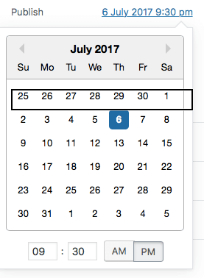
What have I seen improve in Gutenberg accessibility?
Block selector – was inaccessible
Searching for blocks – improved
Date picker – was inaccessible
Focus indicators – improved
Keyboard shortcuts – large selection
Navigation between regions – now possible
Publishing a post – now doable

Slide 21
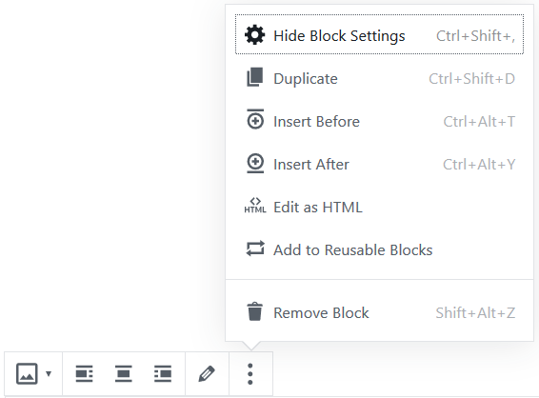
What still causes friction?
Still a lot of keystrokes required to achieve tasks
Controls hidden away and less discoverable
Different toolbars used to manipulate block content
Multiple scrollbars in some circumstances
Unexpected behaviours e.g. images always insert full size
Notes:
Keyboard/screen reader users primarily use Tab / Shift + Tab to move about

Slide 22
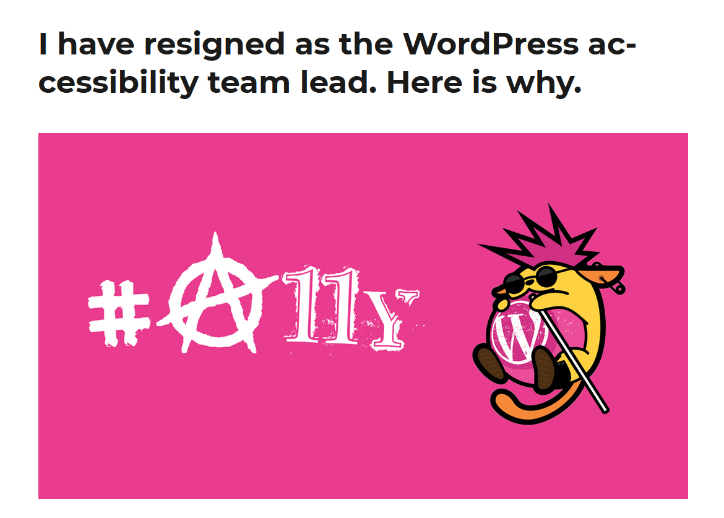
What’s happened recently re: Gutenberg and accessibility?
https://rianrietveld.com/2018/10/09/i-have-resigned-the-wordpress-accessibility-team/
Notes:
4 main reasons:
No-one in the a11y team had experience with React
No-one outside the team who knew both a11y & React was willing to work for free
Accessible code was changed later to inaccessible code
Lack of keyboard testing before implementation of components

Slide 23
Opinion on Gutenberg accessibility, October 2018
“While the Gutenberg team has worked hard to implement some fundamental accessibility features (e.g. focus management, navigate landmark regions), the overall user experience is terribly complicated for users with accessibility needs at the point the new editor is barely usable for them.
The main reason for this lack of overall accessibility is in the overall Gutenberg design, where accessibility hasn’t been incorporated in the design process.
Feedback from accessibility users has been constantly evaluated and Gutenberg is actually a regression in terms of accessibility level, compared to the previous editor.”
- Andrea Fercia
Notes:
Highlights are mine
Published with Rian’s resignation post, October 9 2018

Slide 24
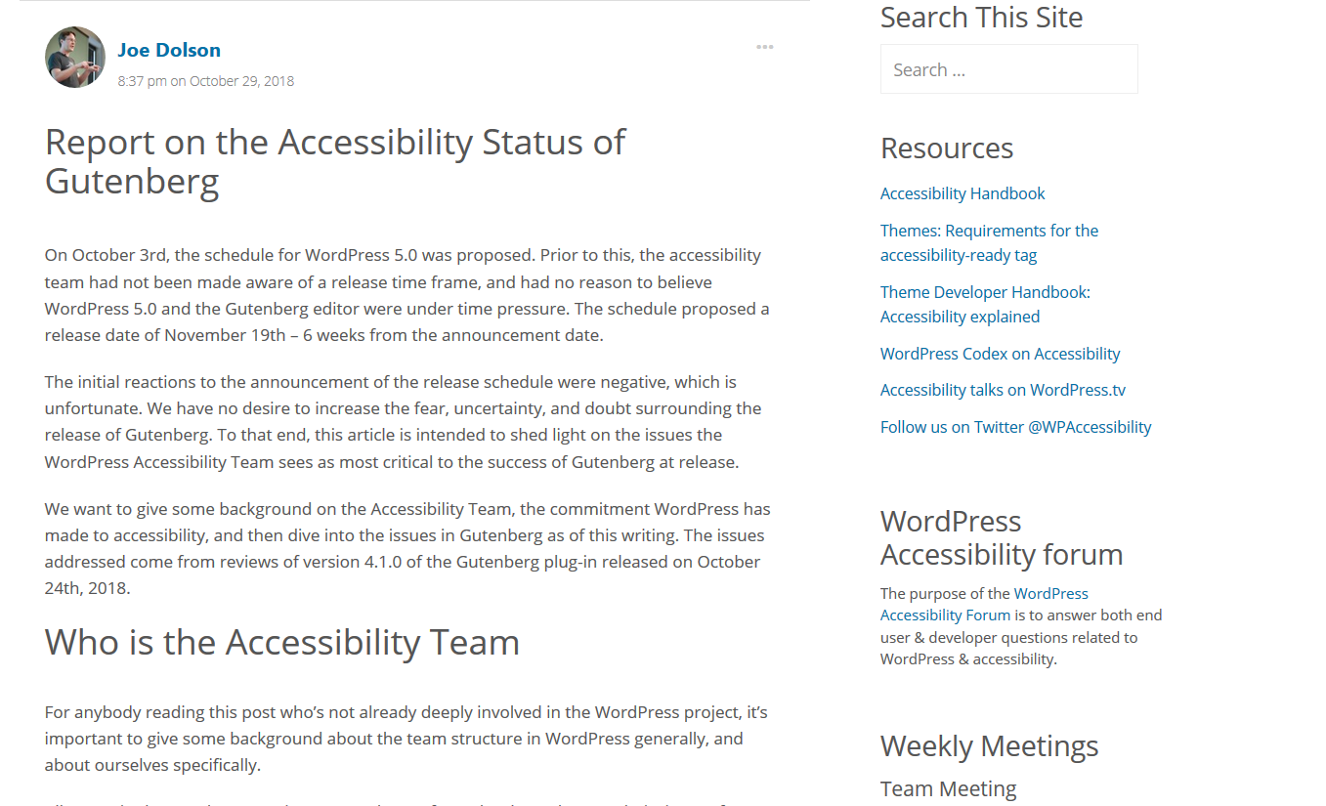
https://make.wordpress.org/accessibility/2018/10/29/report-on-the-accessibility-status-of-gutenberg/
Notes:
I am part of the WordPress Accessibility team
Meetings on Friday afternoons

Slide 25
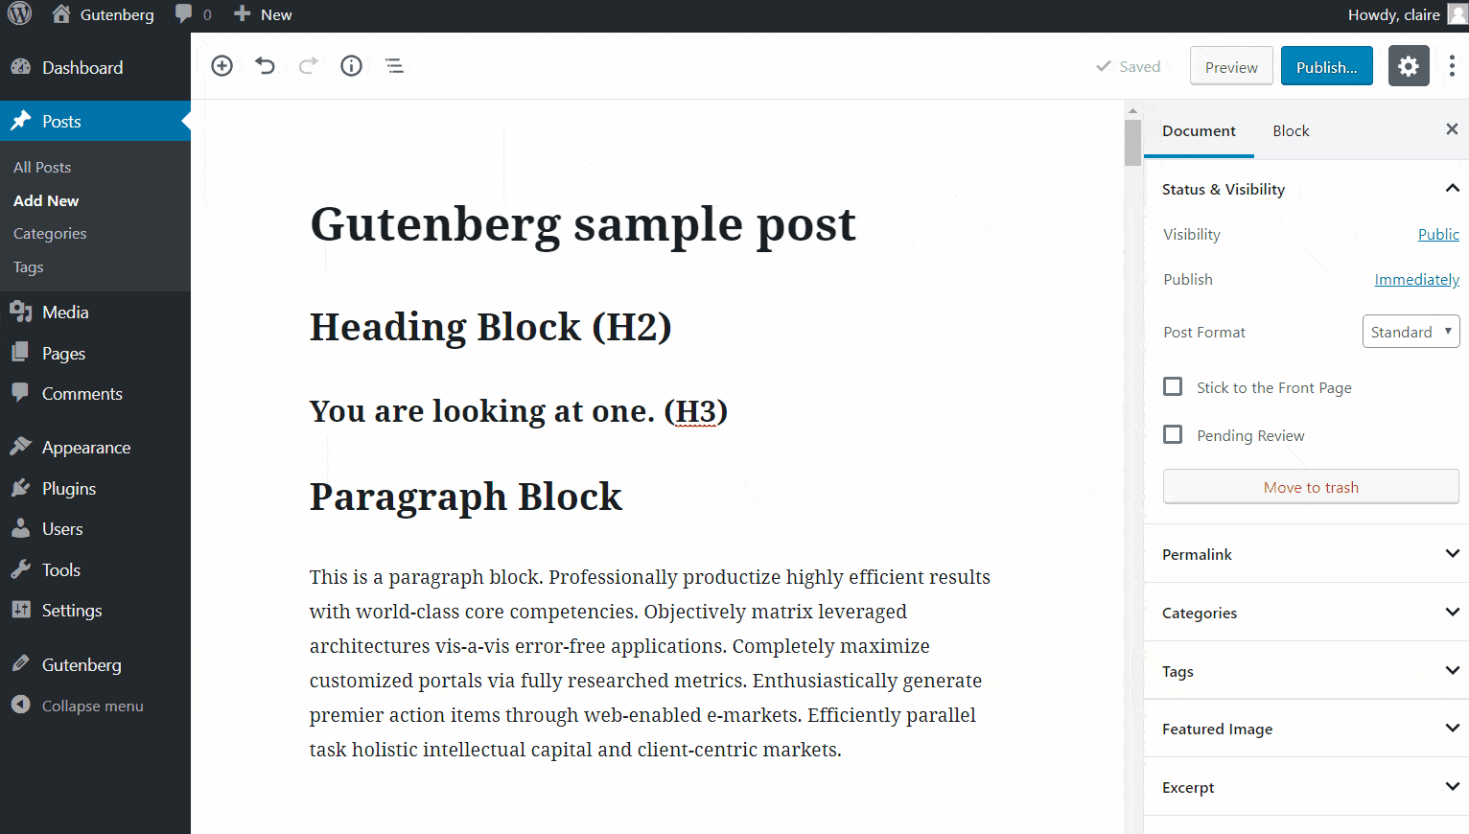
Cognitive Load & Complexity Inconsistent User Interface Behavior
Notes:
There’s just a lot going on! Mouse over things or click on things and watch the UI changes.

Slide 26
Accessibility Anti-Patterns
Notes:
Labels preferred to placeholders

Slide 27
Accessibility Anti-Patterns
https://thomasbyttebier.be/blog/the-best-icon-is-a-text-label
Notes:
Icon buttons – have to hover over them or tab to see what they do

Slide 28
Keyboard Shortcuts
Notes:
Users can’t remap them
Some shortcuts have been changed – one to delete a block was the one to restart Linux

Slide 29
Keyboard Navigation
Notes:
Write and publish a post using the keyboard only: add a title, a paragraph, headings, image with alt text and caption, a list. Change the heading size, add a link and publish.
https://make.wordpress.org/accessibility/gutenberg-testing/
https://chrome.google.com/webstore/detail/focus-indicator/heeoeadndnhebmfebjccbhmccmaoedlf/related

Slide 30
Accessibility team statement, 29 October 2018
…we believe that Gutenberg is less accessible than the existing classic editor, though it offers many great features that are not available in the current editor.
However, based on its current status, we cannot recommend that anybody who has a need for assistive technology allow it to be in use on any sites they need to use at this time.
https://make.wordpress.org/accessibility/2018/10/29/report-on-the-accessibility-status-of-gutenberg/

Slide 31
Gutenberg and UX
useful
usable
desirable
valuable
findable
credible
accessible
Notes:
Useful. 500k installs of the Classic Editor. Testing? Don’t like Gutenberg? We don’t know yet.
Usable. Mixed. Intuitive, not intuitive.
Desirable. Mixed. Polarising reactions. Love/hate.
Findable. Hidden elements. Lots of UI changes, permalink section now in sidebar after saving.
Accessible. The commitment is there, but it’s not ready. Wasn’t factored in from the start.
Credible. Some users have been turned off by early bad experiences. They may not come back.
Valuable. Wait and see. Plugin and theme developers have done a lot of prep.

Slide 32
What can you do to help make Gutenberg better?
Try the Gutenberg plugin or WordPress 5.0 Beta and:
Add a response on the Gutenberg poll: https://wordpressdotorg.survey.fm/gutenberg-support
Leave a review on the Gutenberg plugin page: https://wordpress.org/support/plugin/gutenberg/reviews/
Create an issue on the Gutenberg GitHub site: https://github.com/WordPress/gutenberg/issues
Join the Make WordPress Accessible team https://make.wordpress.org/accessibility/
Notes:
I’ve been writing the Gutenberg user manual for ATs – you are welcome to help!

Slide 33
Thank you! Questions?
https://www.abrightclearweb.com
@abrightclearweb
claire@abrightclearweb.com

